Slide 1
Community Basics:
Checking the Library

Slide 2
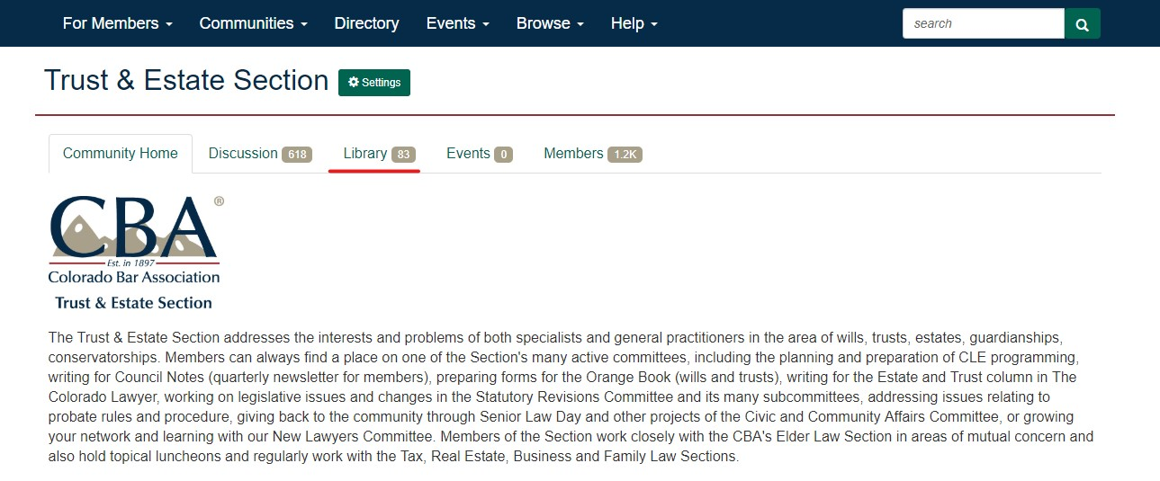
Choose your desired Section page. Click ‘Library’:

Slide 3
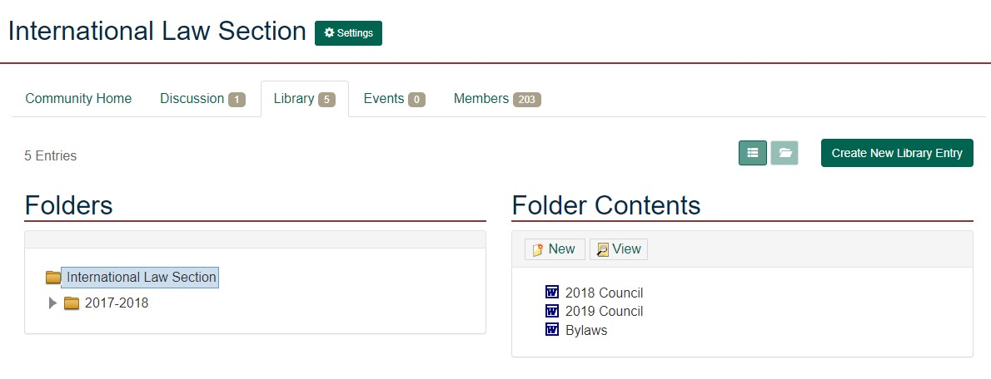

Slide 4
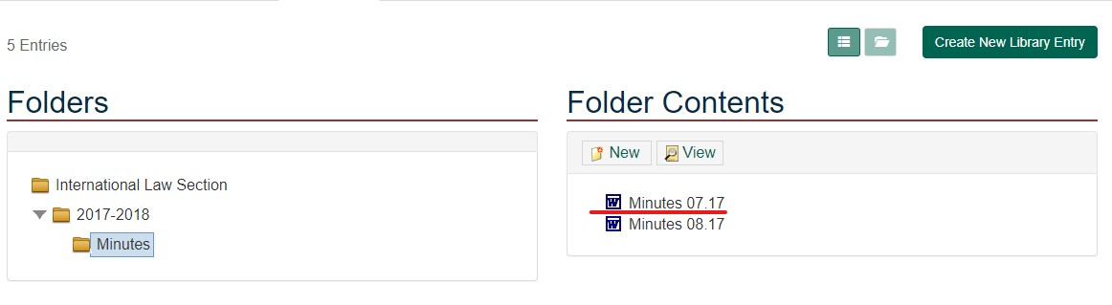
Choose the desired content file:

